Slide 1
Recspicy /Simple yet elegant/
James McGuigan & Steven Foster

Slide 2
Problem Statement
What problem do we want to solve?
What are we looking to create?
How can our page provide “ease of use” to all users?
What features makes us better than existing websites?

Slide 3
Mission Statement
Our Purpose
Simple yet elegant in design and in theory?
New recipes powered by the people!

Slide 4
Our Goals:
Who is our intended audience?
Why we are making this?
What are our intentions?

Slide 5
Tech Stack
FrontEnd
HTML
CSS
Javascript
Backend
PhP
Restful API
Database
MongoDB

Slide 6
Project Description
This is our project
We are building a website to provide a platform that is easy to use, provides user interest, supports page exploration and engagement, and is fully supported by the community who uses it.
This is what we intend
We want users to user our platform for their own benefit we want them to create and share new and unique recipes to add to our platform and be available for others to use.
We want users to use our system to their own benefit with features such as creating a meal planner or having the ability to print out recipes of their own or others creations.
What we want to include
we want users to have the ability to not only search their own or other users creations but have the same availability to user our service to find recipes already publicly accessible for their own convenience
We want simplicity for the user and this is how we intend to do that!

Slide 7
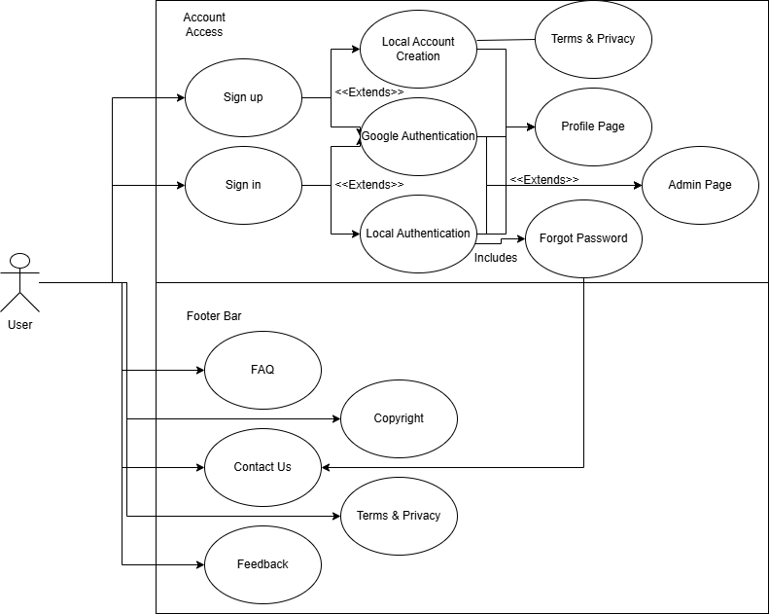
Use Case 1: Welcome Page
Welcome/ Landing page
Introduce the website
Include a design and logo
Creation of accounts
Available sections
sign in
sign up
Footer navigation
What pages user can navigate and visit.

Slide 8
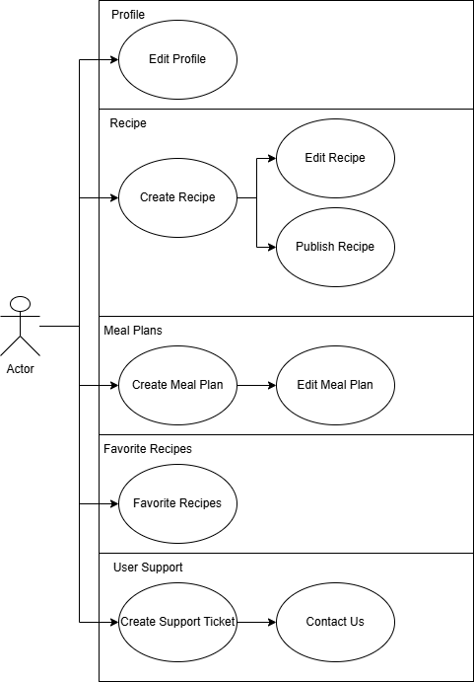
Use Case 2: Profile
From our Landing page, we intend to…
This is how our profile will be structured.
User will have the ability to update this page.
Users will have these features as intended inclusion from our website.
Profiles will be uniform in design yet unique to users preference.
This will be based off of features we will include in our design.

Slide 9
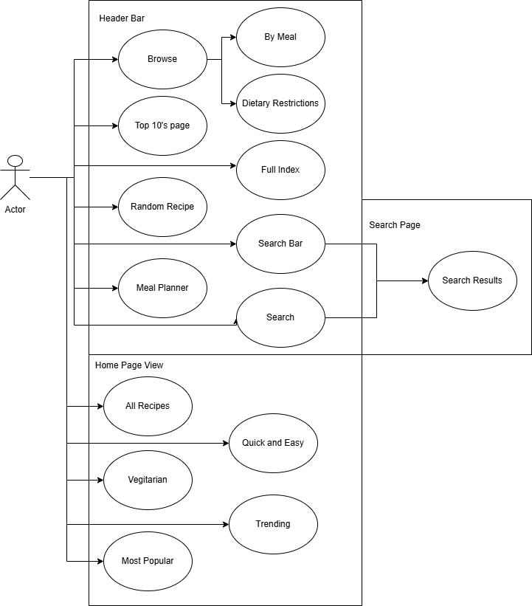
Use Case 3: Home Page
The base of our website.
Features and navigation included for our project.
Our purpose of include these things and not others.
How we intend users to utilize their profiles and our system.
Navigation bar and the home page.

Slide 10
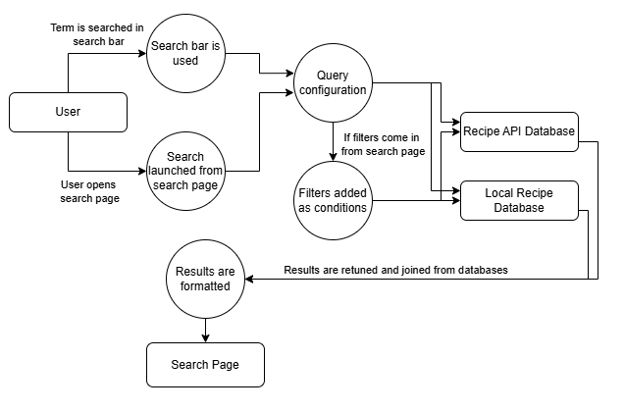
Use Case 4: Filtering
The purpose of our filters.
Why are we filtering in this way?
What the user can search?
API Recipes
Filters will be placed in the PHP
Stored Recipes
Filters will be placed in the recipe creation query and stored in arrays.
We will use check boxes.

Slide 11
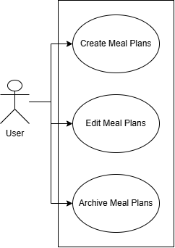
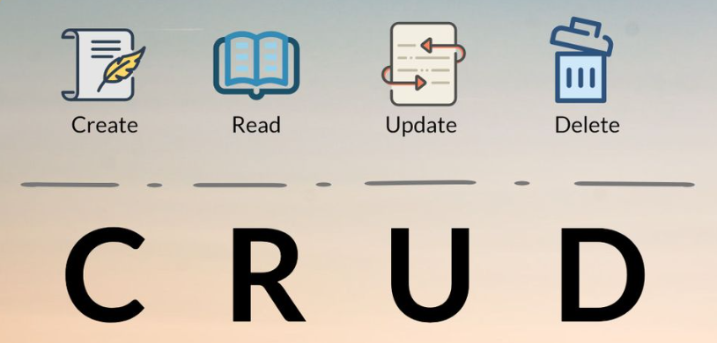
Use Case 5: Meal Planner
The user will Create a meal Plan
The user can Change the meal plan
The user can Update the meal plan
The user can Store the meal plan
The user can Delete the meal plan
Monday - Sunday
Inclusion of Nutrition API
Will filter information and provide nutrition facts

Slide 12
User Intended Actions
- The Landing Page
Welcome Message & Logo
Information, About Us
Our Features
Register / Sign-in
Footer Navigation
Additional pages

Slide 13
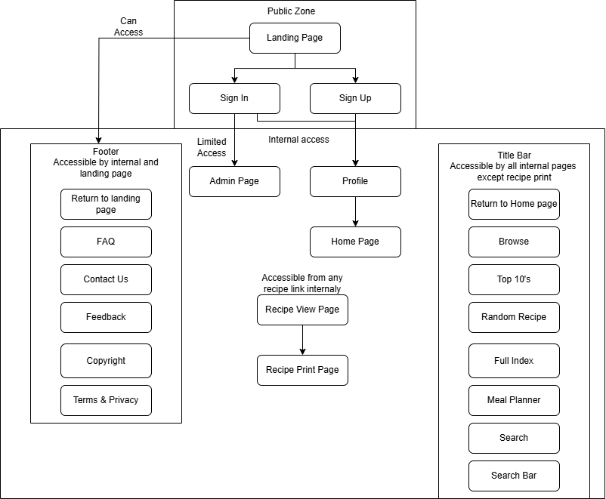
User Intended Actions - Entering the Website
What we want to see from the user.
Why we want to see these behaviors.
What we can do with this information.
Why feedback is so important.
Page tracking and analytics.

Slide 14
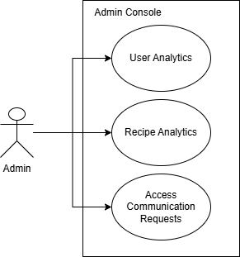
User Intended Actions
- The Admin Role
Our Admins Purpose
Assistance and user support.
Information:
Identification and gathering.
Feedback.
Database Management

Slide 15
Why record information if we aren’t currently using it?
well we are!
Data Analytics
Recipe tracking
Optimization
Performance
Advancement for a larger platform in the future
ratings = featured recipes
viewed pages = frequently visited
tags = optimized filters
user creations = growing support

Slide 16

The Product
~~~Recspicy~~~

